Slide 1

.
Veltech Multitech Dr.Rangarajan Dr.Sakunthala Engineering College
#60,Avadi-Veltech Road,Avadi,Chennai,Tamil Nadu 600062
Project Title
AN INTELLIGENCE MINING SYSTEM FOR DIAGNOSING CERVICAL CANCER
Batch No: 1
Guided by Presented By
Mr.P.Robert M.Tech., S.Anand
Asst Professor, R.Jeeva
IT Department. P.Sabarinathan

Slide 2
ABSTRACT
In health care centers and hospitals, millions of medical images have been generated daily. Analyses have been done manually with an increasing number of images. In the recent past, the development of Computer Aided Diagnosis (CAD) systems for assisting the physicians for making better decisions have been the area of interest. This has motivated the research in creating vast amount of image database. Computer output has been used as a second opinion for radiologist to diagnose the information more confident and quicker mechanism as compared to manual diagnosis. The goal is to design a system that could help the doctors to diagnose the cervical cancer with higher accuracy in minimal period of time. As the premise of feature extraction and pattern recognition, image segmentation is one of the fundamental approaches of digital image processing. It is a preprocessing step in many algorithms and practical vision system. In image segmentation, digital image divided into multiple set of pixels.

Slide 3

LITERATURE SURVEY
Cervical cancer is the second most common cancer in women worldwide, and it is the principal cancer of women in most developing countries, where 80 percent of cases occur. Molecular epidemiologic evidence clearly indicates that certain types of human papillomavirus (HPV) are the principal cause of invasive cervical cancer and cervical intraepithelial neoplasia. More than 80 HPV types have been identified, and about 40 can infect the genital tract.

Slide 4
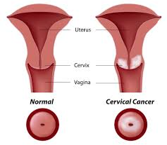
LITERATURE SURVEY(contd..)
Genital HPV types have been subdivided into low-risk types, which are found mainly in genital warts, and high-risk types, which are frequently associated with invasive cervical cancer. There is, however, no consensus concerning the categorization of many HPV types with low prevalence according to risk. Moreover, the number of putative high-risk types varies from 13 to 19, and only 11 HPV types (16, 18, 31, 33, 35, 39, 45, 51, 52, 56, and 58) are consistently classified as entailing high risk. For these reasons, clear-cut criteria for classifying HPV types into low-risk and high-risk groups are needed. These criteria should be based on molecular epidemiologic studies that provide risk estimates and on functional evidence of the oncogenic potential of the various HPV types. A classification of HPV types based on their phylogenetic relationship has been proposed, but it has not been tested epidemiologically.

Slide 5
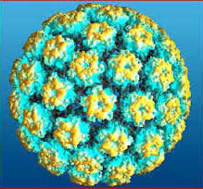
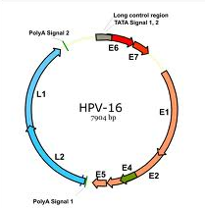
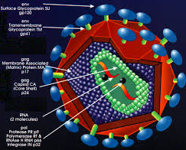
LITERATURE SURVEY(contd..)
Cervical cancer is the commonest occurring cancer among women in sub-Saharan Africa, accounting for an estimated 20-25% of all new cancers among women . The World Health Organization (WHO) estimates the annual age-standardized cervical cancer incidence rate in Ghana as 29.3/100,000, which is four times the US rate, while the mortality rate is 23.8/100,000, or ten times the US rate . Some studies have reported that among gynecological cancers diagnosed at a large hospital in Ghana, cervical cancer accounts for about 60% of cases, while 70% of these cases are diagnosed at an advanced stage.

Slide 6
EXISTING SYSTEM
Segmentation algorithms are based on one of two basic properties of intensity values discontinuity and similarity.
First category is to partition an image based on abrupt changes in intensity, such as edges in an image.
Second category is based on partitioning an image into regions that are similar according to predefined criteria.
Histogram Threshold approach falls under this category. Threshold segmentation techniques can be grouped in three different classes:
1)Local techniques are based on the local properties of the pixels and their neighborhoods .
2) Global techniques segment an image on the basis of information obtain globally .
3) Split, merge and growing techniques use both the notions of homogeneity and geometrical proximity in order to obtain good segmentation results.

Slide 7
PROPOSED SYSTEM
Pure merging methods are, however, computationally expensive because they start from such small initial regions (individual points). We can make this more efficient by recursively splitting the image into smaller and smaller regions until all individual regions are coherent, then recursively merging these to produce larger coherent regions. First, we must split the image. Start by considering the entire image as one region.
1) If the entire region is coherent (i.e., if all pixels in the region have sufficient similarity), leave it unmodified.
2) If the region is not sufficiently coherent, split it into four quadrants and recursively apply these steps to each new region.

Slide 8
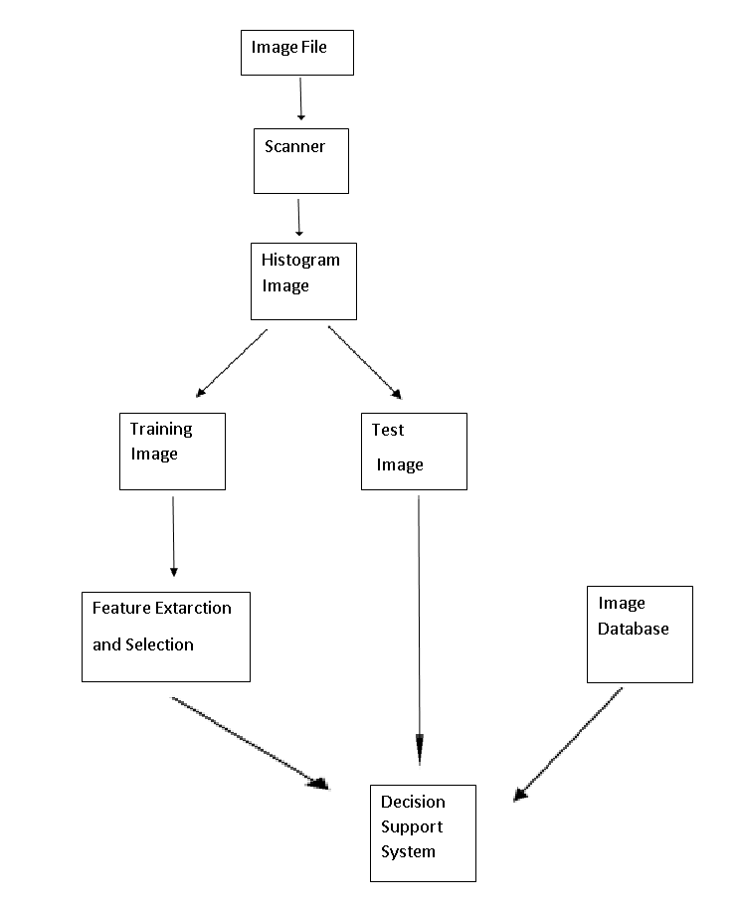
SYSTEM ARCHITECHTURE

Slide 9
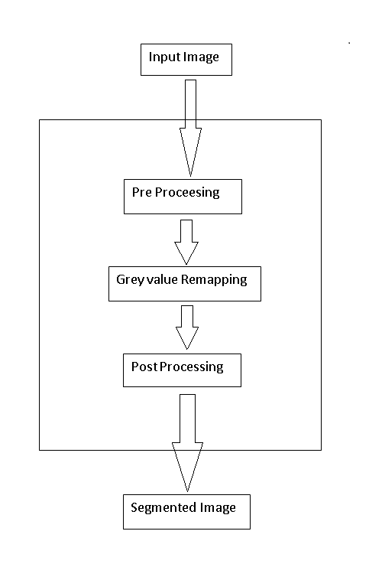
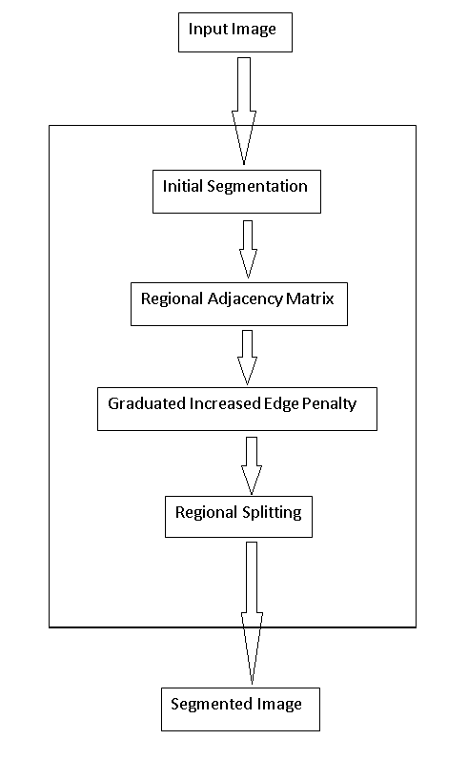
COMPARISION WITH EXISTING SYSTEM
THRESHOLD METHOD
REGIONAL SPLITTING and CLASSIFIACTION METHOD

Slide 10
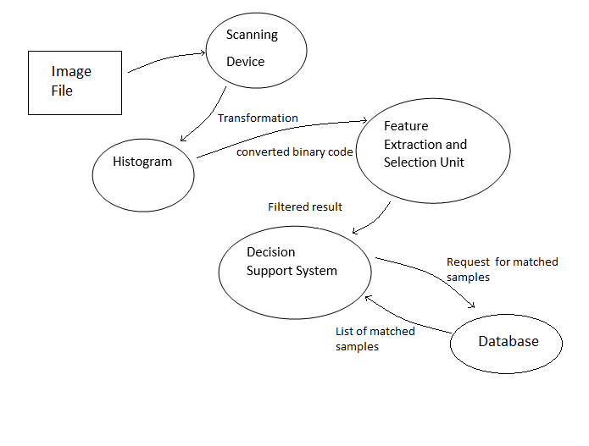
DATA FLOW DIAGRAM

Slide 11
MODULE LIST
Input Module
Transformation Module
Preprocessing Module
Feature Extraction Module
Feature Selection Module
Computation Module
Report Module

Slide 12
MODULE DESCRIPTION
INPUT MODULE
The image to be segmented will be given as the input to the system through an image scanner.
The scanned image is forwarded to the histogram so that it could be transformed.
TRANSFORMATION MODULE
The image forwarded from the scanner will be given to the histogram which will be converted as the binary code.

Slide 13
PREPROCESSING MODULE
In general, images with noise reduce the efficiency of the system.
Therefore, preprocessing of medical images is essential for increasing the efficiency and reducing the complexity of the CAD system
FEATURE EXTRACTION MODULE:
The most difficult aspect of CAD system in feature analysis and extraction is to extract a set of useful features that should be able to explore the characteristics of the tissues at cervix.
Types of features
Texture feature
Histogram feature

Slide 14
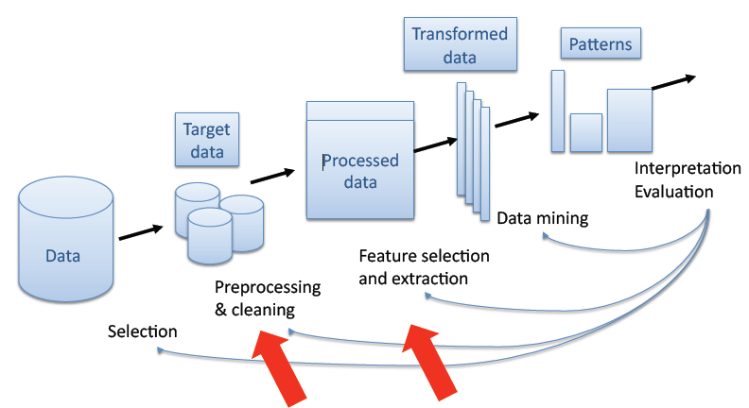
FEATURE SELECTION MODULE

Slide 15
FEATURE SELECTION MODULE
It is one of the important tasks to identify and extract relevant features in order to reduce the complexity of processing.
Not all the features of an image are useful for rule extraction.
Some of the above features are strongly correlated with each other. A feature selection procedure is applied to select a subset of the features in order to improve the performance of the system.
In our system, we used linear technique for feature reduction called PCA.
This method selects optimal features that are correlated with each other.

Slide 16
MODULE DESCRIPTION(contd..)
COMPUTATION MODULE:
This module involves the following computations
Initial Segmentation
GIEP
Region Adjacency Graph
Support Vector Machine
SVM classification

Slide 17
INITIAL SEGMENTATION AND GIEP
The input image is taken and is given for initial segmentation. At first an image is being read and watershed segmentation is performed on that image. This generally eliminates the plateaus defined as the uniform regions, by converting the image to a floating point representation. Here watershed segmentation is done as initial segmentation
The GIEP has two attractive features. First, it utilizes edge information to improve the segmentation on non stationary situations. Second, it provides a simple and elegant method of simultaneously estimating model parameters and searching solutions for the MRF-based formulation.

Slide 18
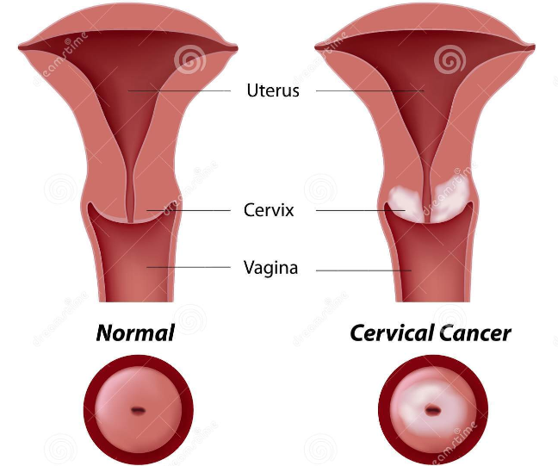
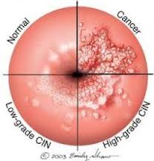
INPUT IMAGE

Slide 19
REGION ADJACENCY GRAPH AND COST OF CHOICE FUNCTION
Then Region Adjacency Graph is drawn for the segmented image. This method equivalently can be used as edge detection and result is satisfied to the topological requirement . Merging is always conducted in such a way that the distortion or cost caused by merging is minimized and there is no further restriction imposed on the shape of the final segmentation result.
The choice of cost function depends on the desired purpose of segmentation. A common cost measure is sse (sum square error): where g(x,y) is the approximation function and h(x,y) is the original data.

Slide 20
SUPPORT VECTOR MACHINE
Support Vector Machines (SVM) is a powerful, state-of-the-art algorithm with strong theoretical foundations based on the Vapnik-Chervonenkis theory. SVM has strong regularization properties. Regularization refers to the generalization of the model to new data.
Advantages of SVM
SVM models have similar functional form to neural networks and radial basis functions, both popular data mining techniques. However, neither of these algorithms has the well-founded theoretical approach to regularization that forms the basis of SVM. The quality of generalization and ease of training of SVM is far beyond the capacities of these more traditional methods.
SVM can model complex, real-world problems such as text and image classification, hand-writing recognition, and bioinformatics and bio sequence analysis.
SVM performs well on data sets that have many attributes, even if there are very few cases on which to train the model. There is no upper limit on the number of attributes; the only constraints are those imposed by hardware. Traditional neural nets do not perform well under these circumstances.

Slide 21
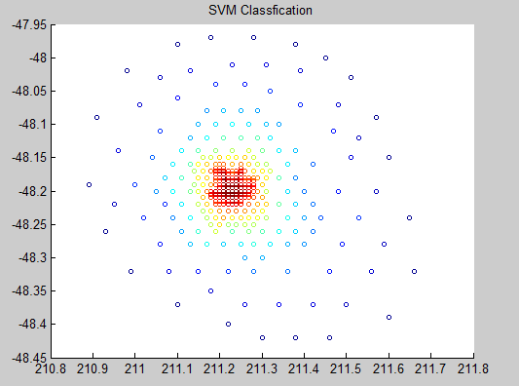
SVM CLASSIFICATION

Slide 22
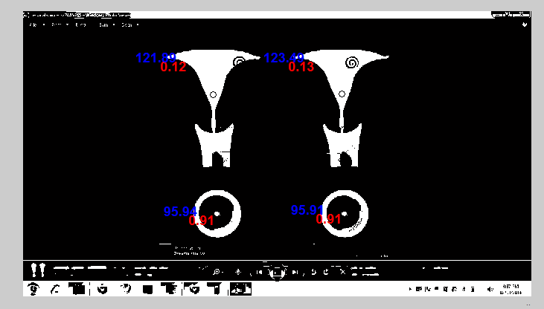
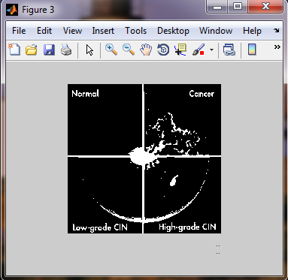
IRGS OUTPUT IMAGE

Slide 23
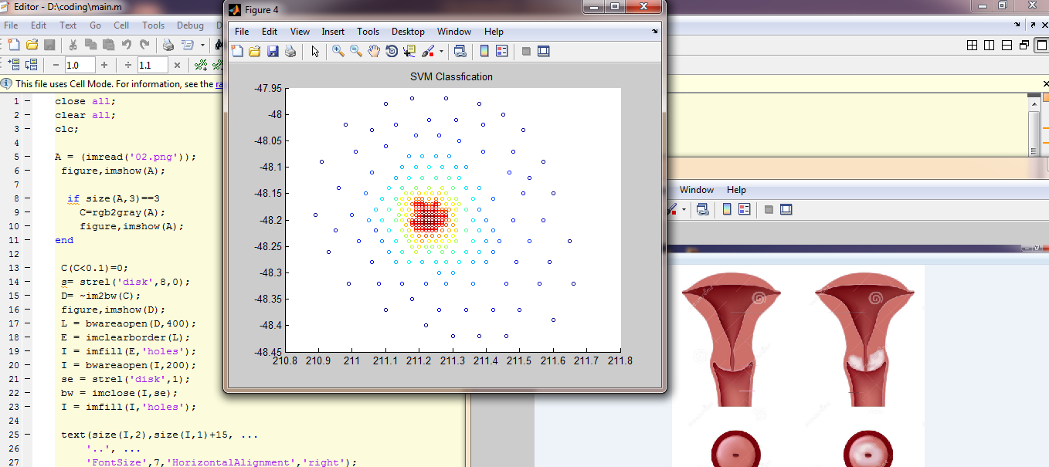
SCREENSHOTS

Slide 24
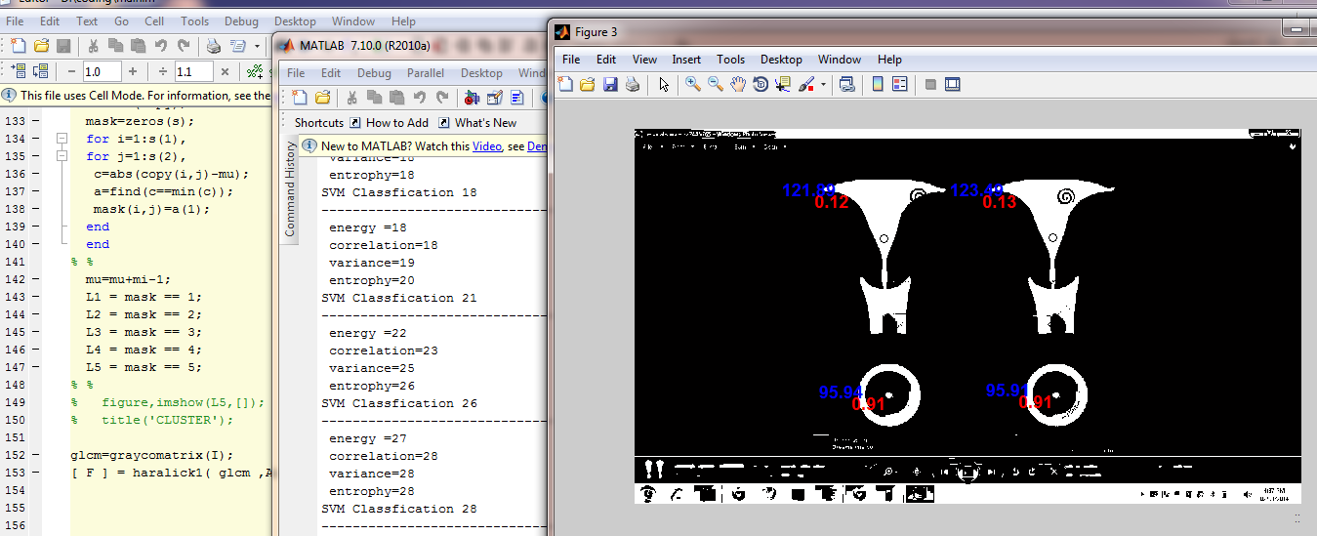

Slide 25
CODING

Slide 26
REQUIREMENTS
Software : MATLAB version 7.6
Collection of scanned images
Set of tissue samples

Slide 27
REFERENCES
J. Agma, M. T. Caetano, X.R. Marcela, and M. A. Paulo, An association rule-based method to support medical image diagnosis with efficiency, IEEE Trans Multimedia 10 (2008), 277–285.
R. Agrawal and R. Srikant, Fast algorithms for mining association rules,Proc Int Conf VLDB, Santiago, Chile, 1994, 487–499.
M.-L. Antonie, A. Coman, and O.R. Zaiane, Associative classifiers for medical images, LNAI 2797, MMCD, Springer- Verlag, New York (2003), 68–83.
I. A. Basheer and M. Hajmeer, Artificial neural networks: fundamentals, computing, design and application, J Microbiol Methods 43 (2000), 3–31.
T. Chan and L. Vese, Active contours without edges, IEEE Trans Image Process 10 (2001), 266–277.

